Slide 1
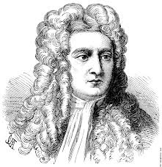
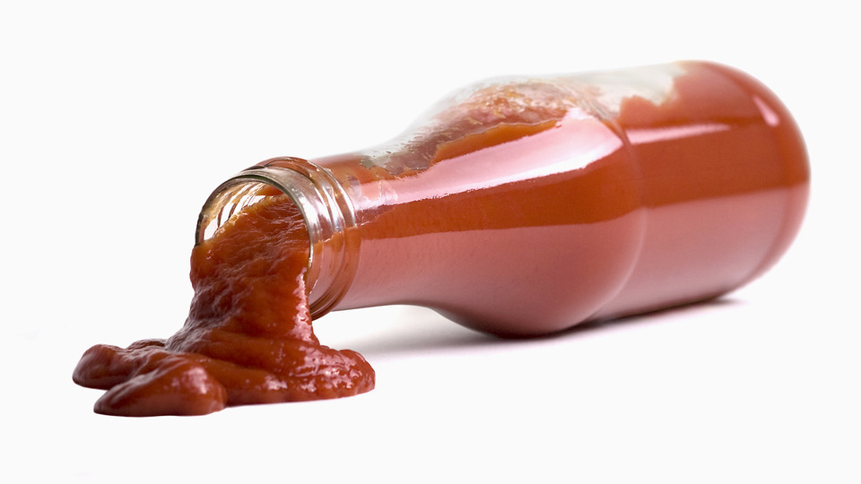
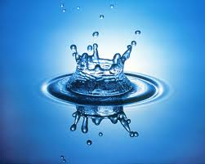
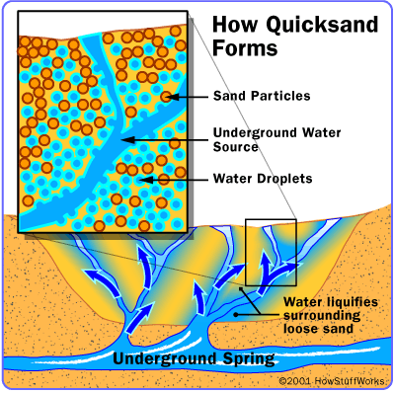
The Science of Quicksand!
Sharon Elementary Science Night
What is Quicksand?
The Science of Quicksand
Quicksand is a colloidal hydrogel consisting of fine granular material. WHAT? In every day terms, quicksand is a mixture of water and sand, dirt or clay, that sometimes behaves like a liquid and sometimes behaves like a solid.
All fluids have a property know as viscosity. Viscosity is the measure of the thickness or resistance to flow in a fluid. Viscosity was first explained by Sir Isaac Newton, and he found that when a force is applied to a fluid, the fluid should flow. These are called “Newtonian” fluids. Some fluids however, get thicker or thinner when a force is applied, and these are called “non-Newtonian” fluids.
Water is an example of a Newtonian fluid. Ketchup (thinner under force) and Quicksand (thicker under force) are non-Newtonian fluids.
Sir Isaac Newton
How Does Quicksand Work?
Quicksand forms in loose sand that is saturated with water and is suddenly agitated. When the water cannot escape the sand, a liquefied soil is created that loses its strength and cannot support its own weight. If more water flows into the sand, the sand particles are forced farther apart. This separation of the sand particles causes the ground to loosen and any weight on the sand will begin to sink through!
You Have the Quicksand, Now What?
Where Can I Find
Quicksand?
Move your fingers slowly through the Quicksand, and notice that the Quicksand behaves very much like a thick liquid; you can move your fingers around freely.
Now, punch or poke the quicksand quickly. What happened?
When you punch or poke the Quicksand the force makes the long corn starch molecules closer together. The impact of the force traps the water molecules between the corn starch to form a semi-rigid structure that acts like a solid!
Quicksand can be found near rivers, creeks, marshes, lakes, or in the tidal beds near the ocean. Really, quicksand can be anywhere there is both a source of sand and rising water !
Supplies to Make Quicksand
One box of cornstarch (16 oz)
Large mixing bowl
Pitcher of water
Spoon
Plastic drip cloth to cover the floor
Water
Food coloring
How to Make Quicksand at Home
Pour approximately 1/4 of the box (about 4 oz) of cornstarch into the mixing bowl and slowly add about 1/2 cup of water. Mix the cornstarch and water with your bare hands.
Continue adding cornstarch and water in small amounts until you get a mixture that has the consistency of honey. (about 1 box of cornstarch to 1 – 2 cups water)
Sink your hand into the bowl of “quicksand” and notice its unusual consistency. Compare what it feels like to move your hand around slowly and then very quickly. You can’t move your hand around very fast! In fact, the faster you thrash around, the more like a solid the gooey stuff becomes. Sink your entire hand into the goo and try to grab the fluid and pull it up. That’s the sensation of sinking in quicksand!
Did you know?
Quicksand in the movies is made from corn starch and water?

