Slide 1
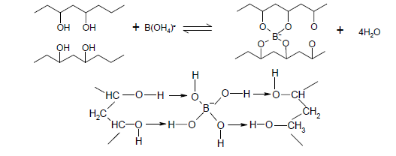
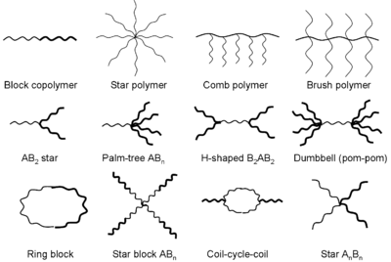
SLIME! An Introduction to Polymers
Sharon Elementary Science Night
What are Polymers?
The Science of Slime
A polymer is a chemical compound or mixture of compounds consisting of repeating structural units. Polymers are made from smaller compounds called monomers, joined together in a chemical reaction.
Poly- means "many"
Mono means "one"
Mer means "part" or "segment".
Many Many Many MONOmers make a POLYmer!
Borate
Elmer's Glue (polyvinyl acetate)
The Borate links the PVA together by “grabbing” the Oxygen (O) atoms in the polymer chain. The reaction releases 4 water molecules (H2O) into the surrounding solution.
Examples of Polymers
The main ingredient in Elmer's Glue is a polymer called Polyvinyl alcohol (PVA)
PVA is an addition polymer of repeating units of [–CH₂-CHOH-]
Sodium Borate is a detergent (soap). Its sold as Borax in the store
Slime can be made by using the borax to “link” the Elmer's glue together! (scientifically the borate crosslinks the PVA, just in case you were wondering!)
Did you know?
Slime as a toy dates back to the 1920′s when it was invented by Nobel laureate Hermann Staudinger
Slime can also be made with natural polymers such as Guar gum and corn starch
Natural Polymers
Cellulose (wood, plants)
Shellac
Wool
Silk
DNA
Synthetic Polymers
Synthetic rubber (tires)
Nylon
Neoprene
Polyvinyl chloride (PVC)
Polyethylene (bottles)
Monomer
Shapes of Polymers
One Slime molecule!
Elmer's Glue (polyvinyl acetate)
Borate cross-linker)
Elmer's Glue (polyvinyl acetate)
Supplies to Make Slime
2 Jars
Elmer’s Glue (120mL)
Borax (sodium tetraborate)
Teaspoon
Measuring cup
Bowl
Food coloring (optional)
How to Make Slime
Pour the glue into the jar. If you have a big bottle of glue, you want 4 oz or 1/2 cup of glue.
Fill the empty glue bottle with water and stir it into the glue (or add 1/2 cup of water).
If desired, add food coloring..
In a separate, mix one cup (240 ml) of water into the bowl and add 1 teaspoon of borax powder.
Slowly stir the glue mixture into the bowl of borax solution.
Place the slime that forms into your hands and knead until it feels dry. (Don't worry about the excess water remaining in the bowl.)
The more the slime is played with, the firmer and less sticky it will become. Have FUN!
Store your slime in a zip-lock bag in the fridge (otherwise it will develop mold)

